Slide 1

EMPLOYEE MANAGEMENT SYSTEM

Slide 2

INTRODUCTION
Full Stack Application – Employee Management System
A employee management system is an application that is designed to manage all the functions of a Employee. It helps to maintain the database of all employees. This system completely automates all your employees activities.
The basic functions of employee management system include overseeing all operations and managing data.

Slide 3
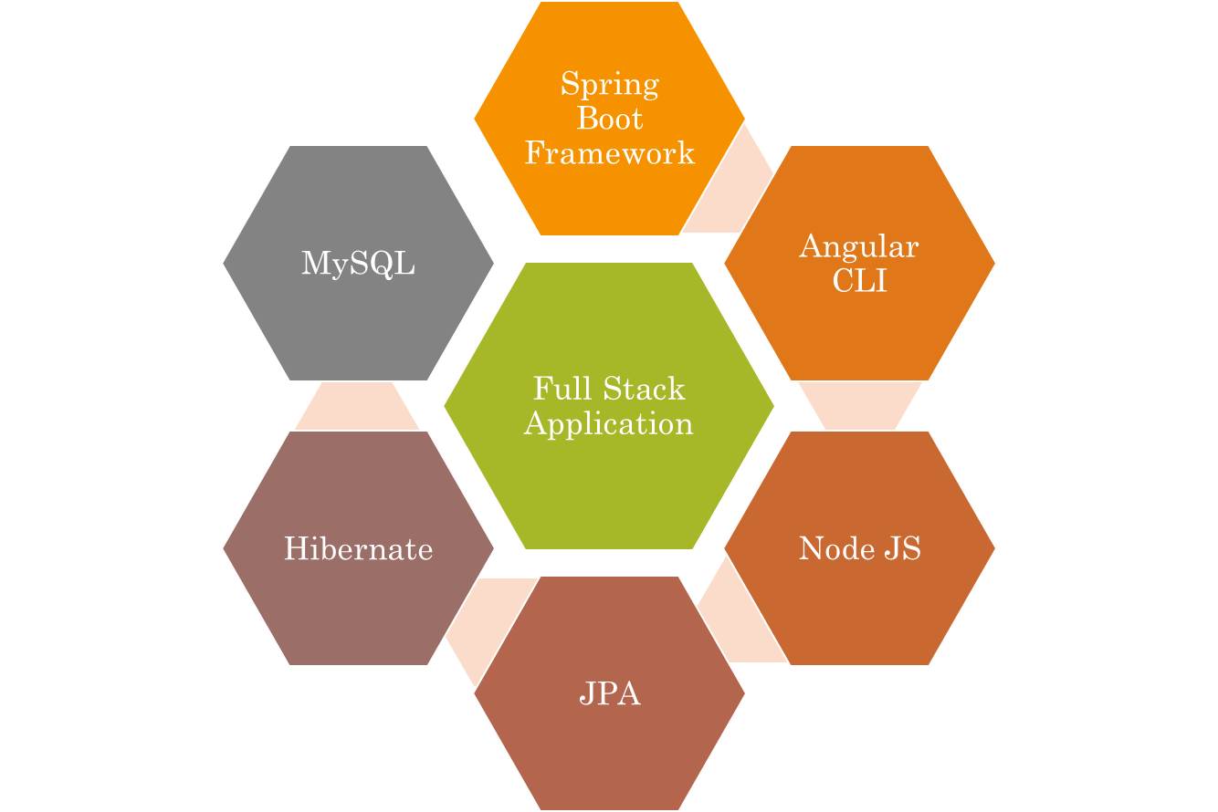
Technologies Used

Slide 4
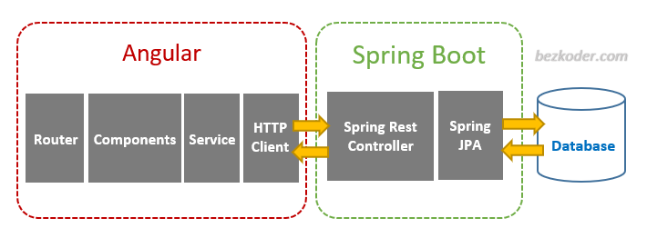


Working of Angular, Spring & (MySQL)

Slide 5
Road-Map of Project
Angular JS
Node JS
Frontend
Spring Boot
Backend
MySQL

Slide 6
CRUD:Operations
View Data
Update Data
Delete
CRUD
Insert Data

Slide 7
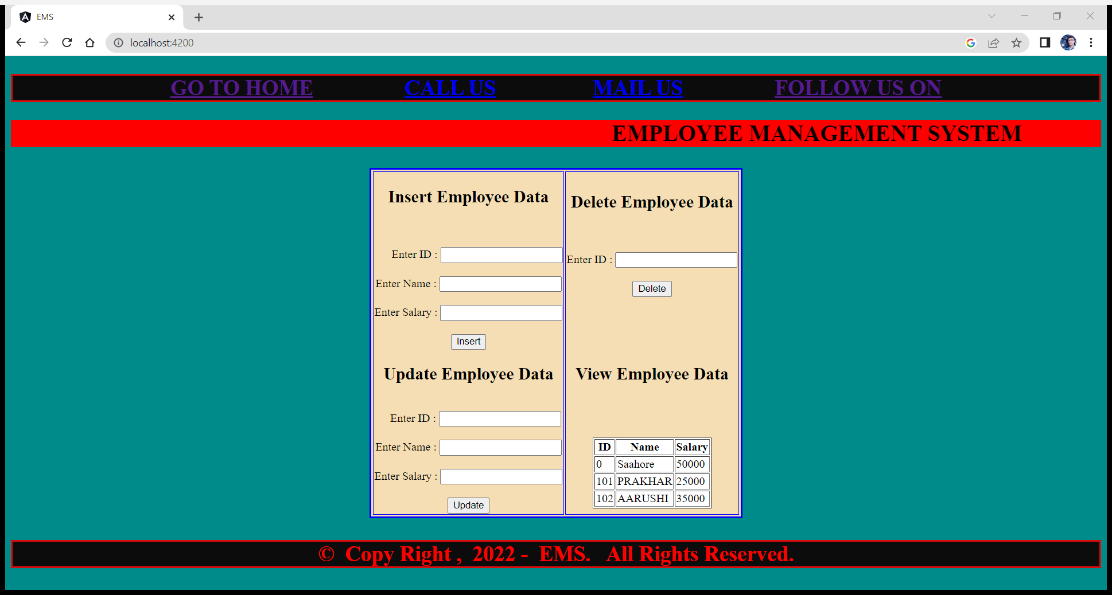
Home Page

Slide 8
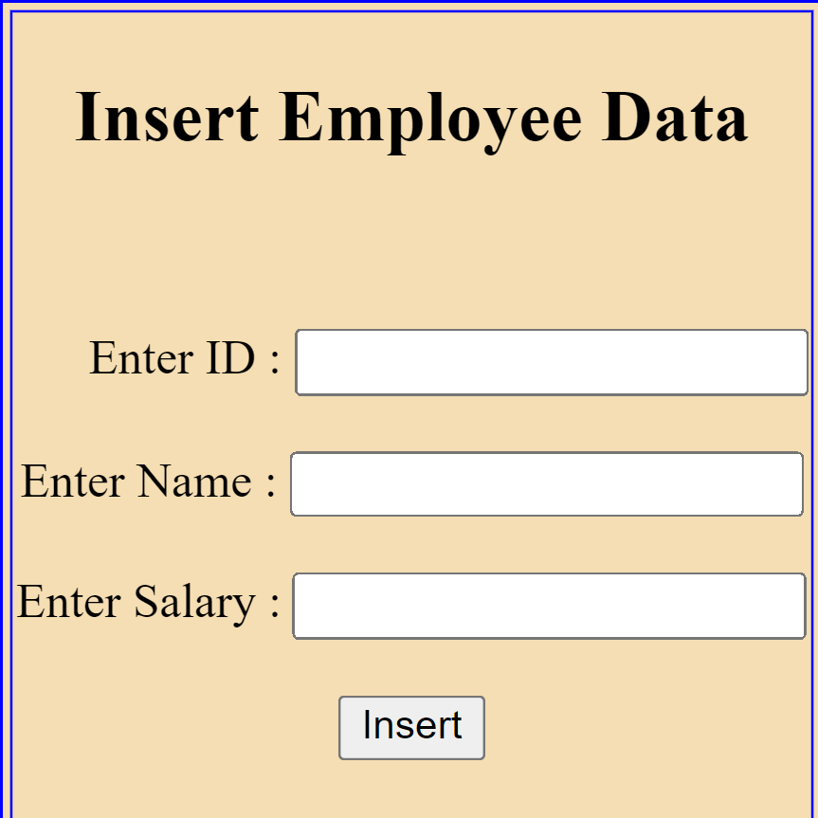
Service:Insert

Slide 9
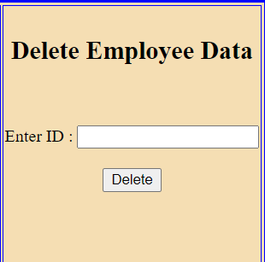
Service:Delete

Slide 10
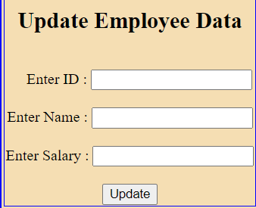
Service:Update

Slide 11
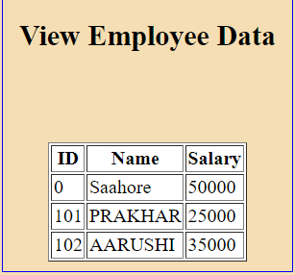
Service:View

Slide 12
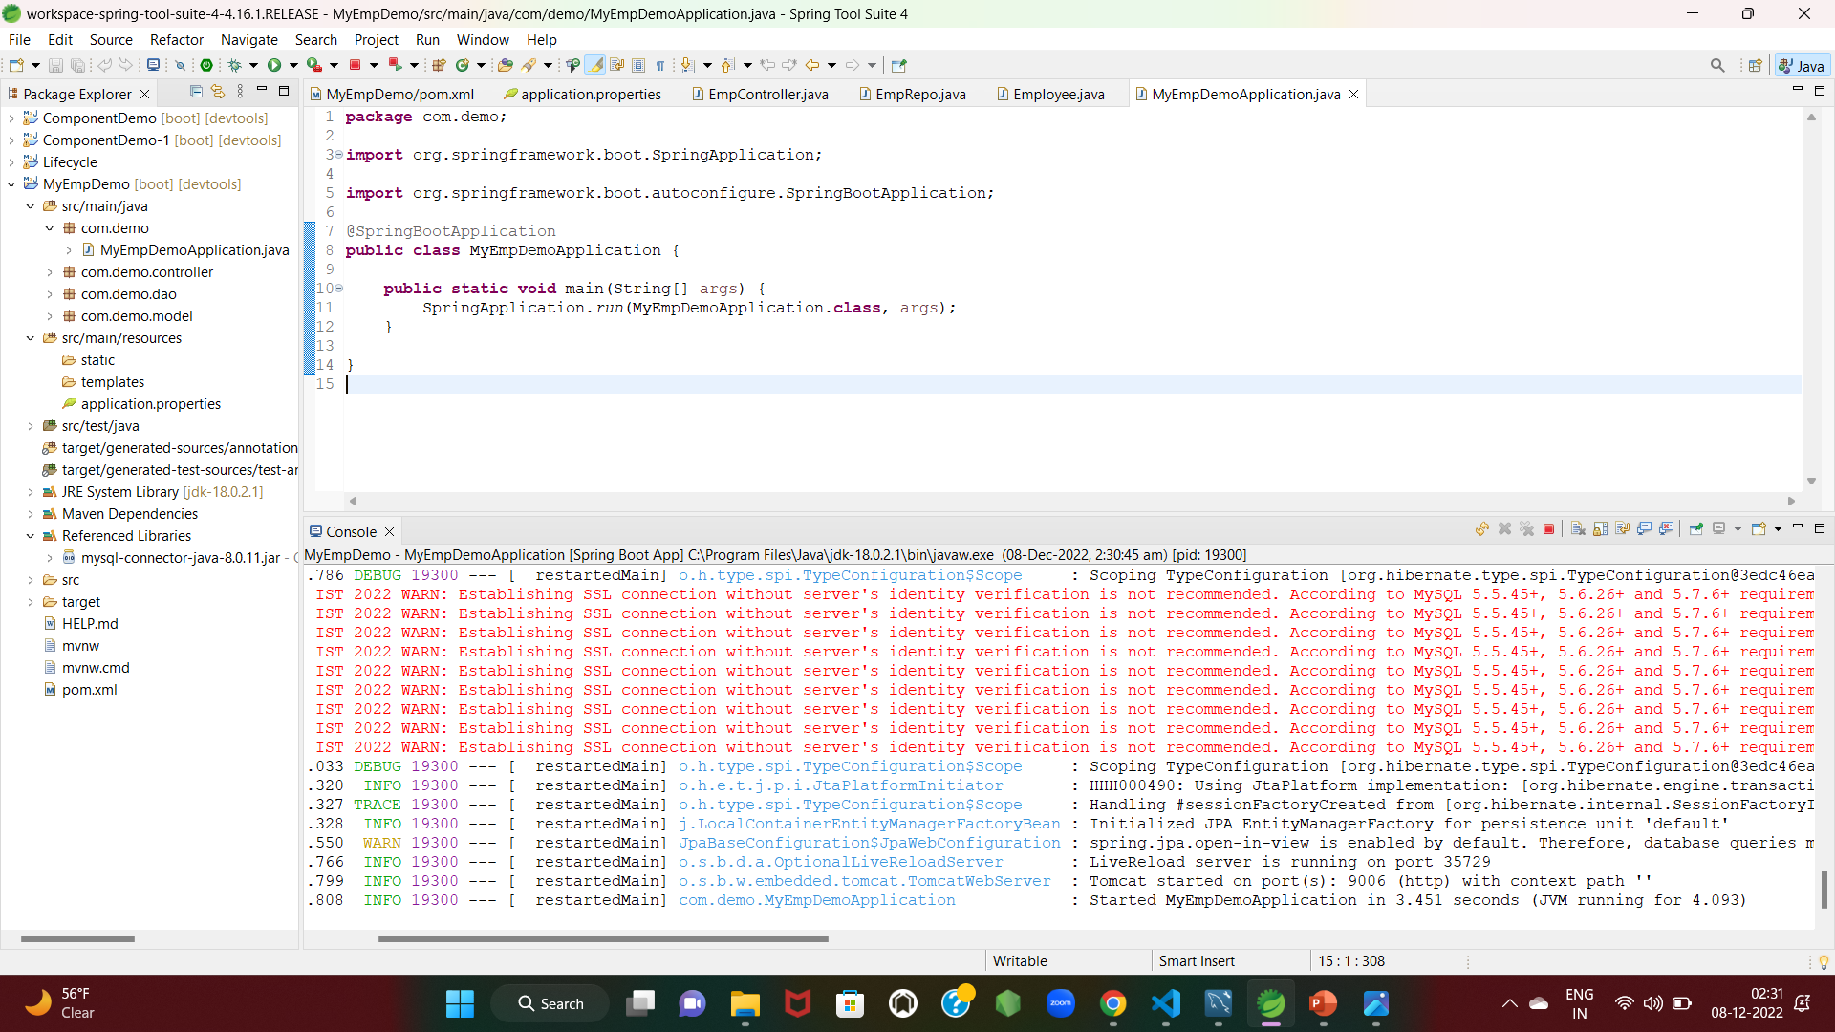
Spring Boot:Application

Slide 13
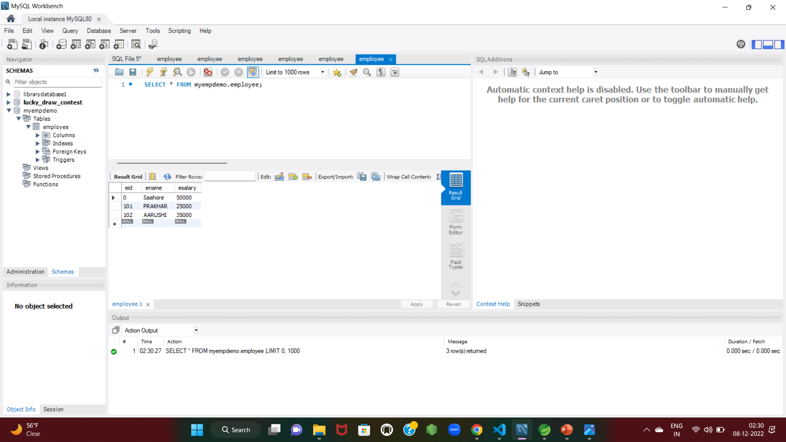
Database:MYSQL

Slide 14
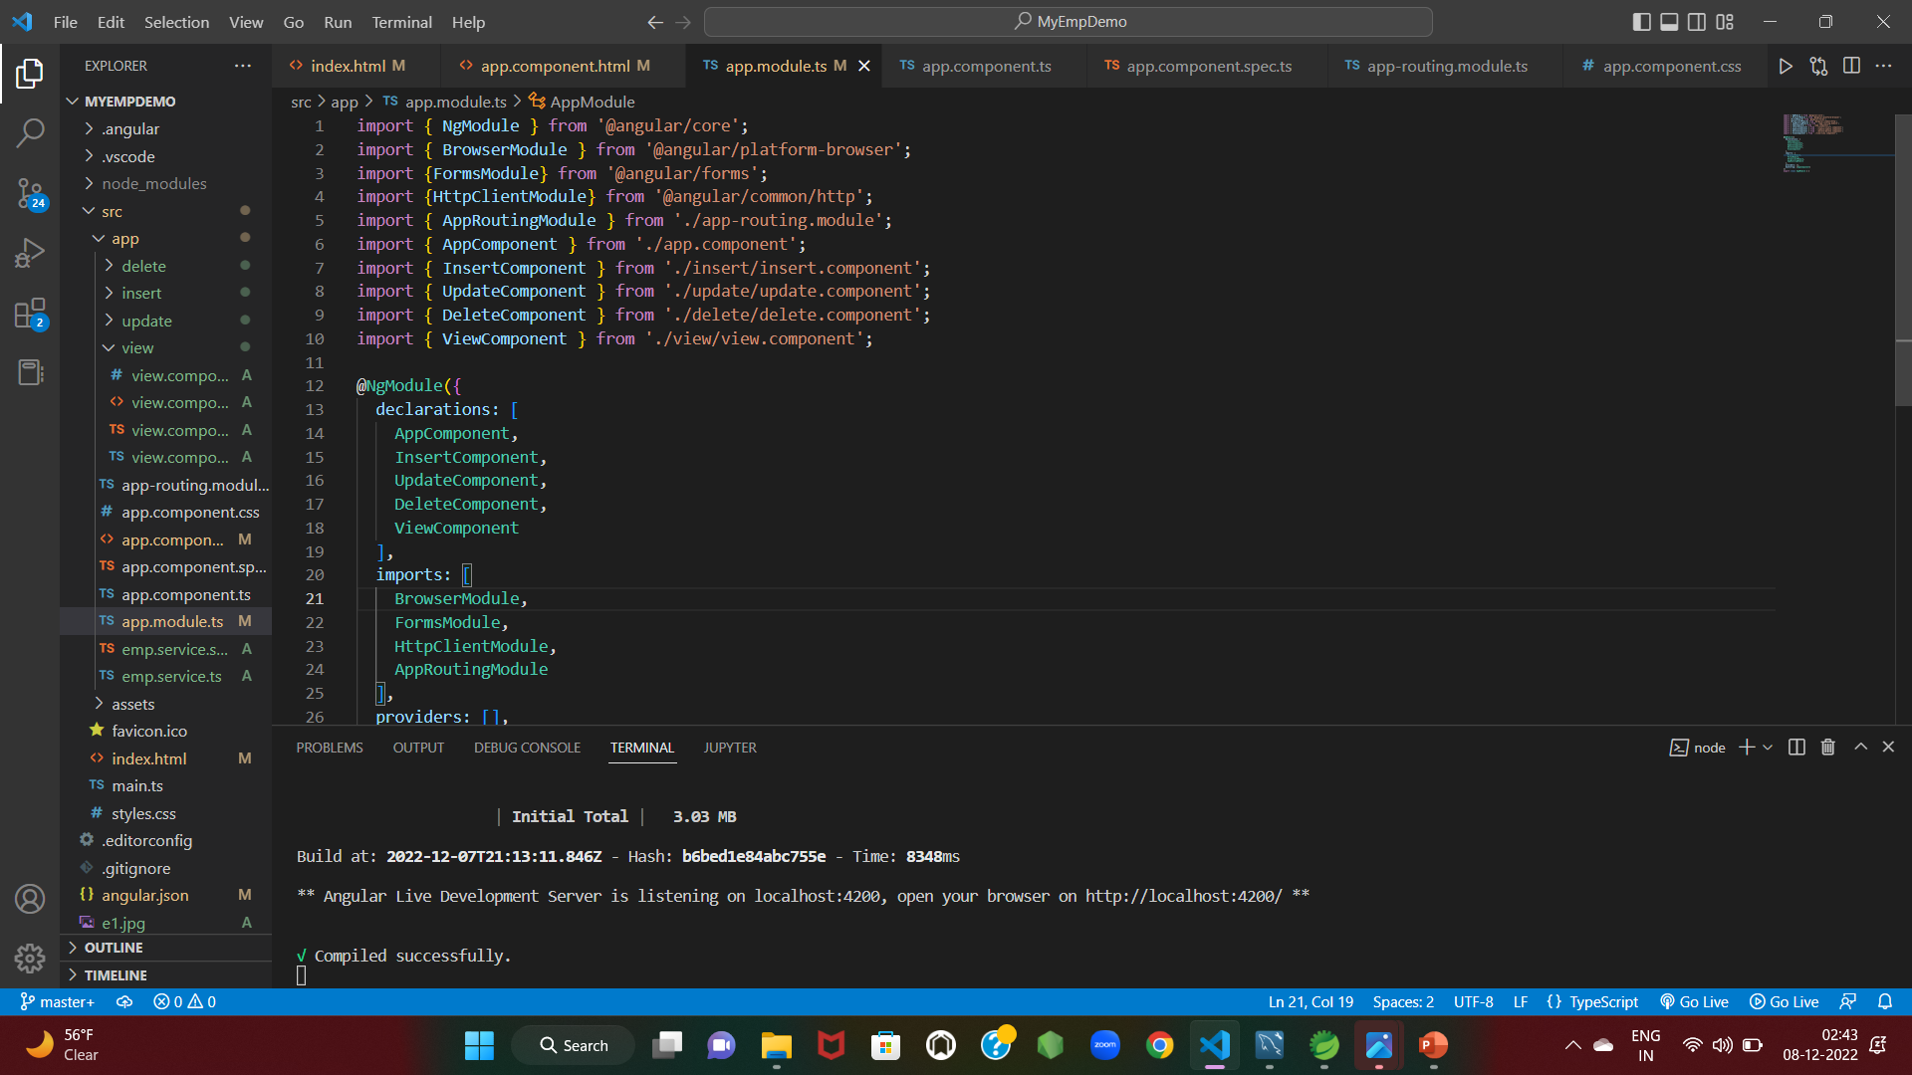
Frontend:Angular JS Node

Slide 15

The scope of this Project is as follows:
To assist the staff details in capturing the effort spent on their respective field.
To utilize resources in an efficient manner by increasing their productivity through automation.
The system generates types of information that can be used for various purposes.
Also it holds various data which can be used when required.

Slide 16

GitHub Link
https://github.com/PRAKHAR75GUPTA/Full-Stack-Application.git
https://github.com/PRAKHAR75GUPTA/Full-Stack-Application-Angular.git

Slide 17

REGARDS
PRAKHAR GUPTA

